Slide 1

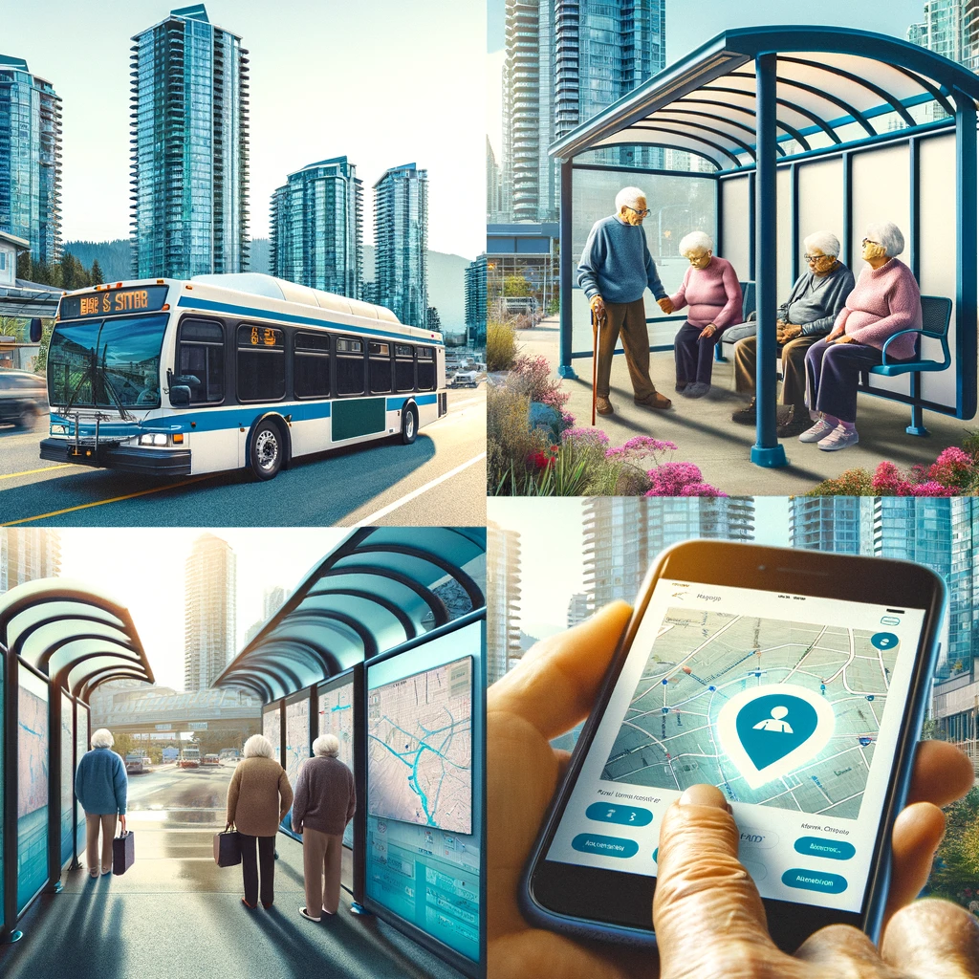
Design of New APP CozyCommute
Harnessing the Power of Data to Improve Customer Service
Notes:
Cassie

Slide 2
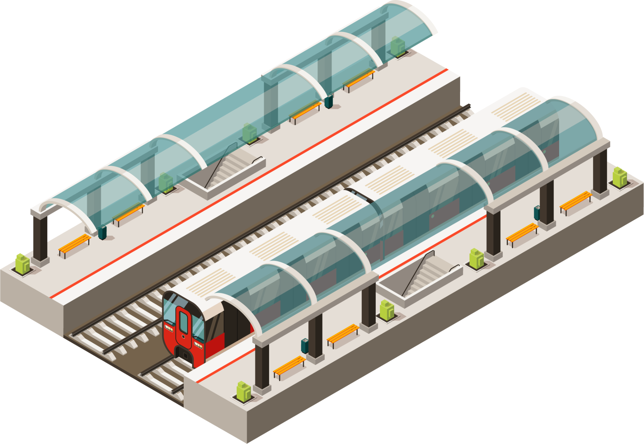
Agenda
Story of Persona
Pain Points
Product Overview: CozyCommute
A Day in the Life (Before CozyCommute)
A Day in the Life (After CozyCommute)
App Demo
Data Assumption
Benefit for Translink
Benefit for Customers
Benefit for Environment
Notes:
Cassie

Slide 3
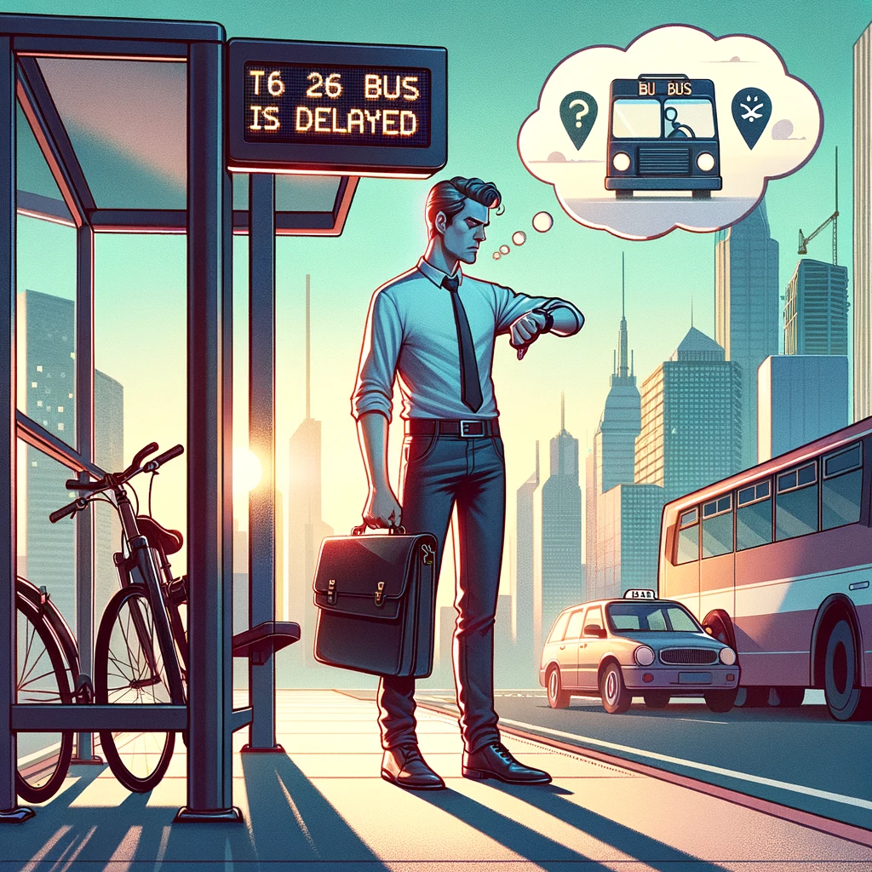
Story of Persona-1
Bob’s Dilemma
Bob is on the verge of losing his job due to repeated lateness.
The bus is consistently late, causing Bob to struggle with punctuality.
Bob only knows in real time when the bus is late from Google Maps and cannot anticipate it ahead of time.
Bob is considering alternative transportation options to avoid being late.
Notes:
Sijan

Slide 4
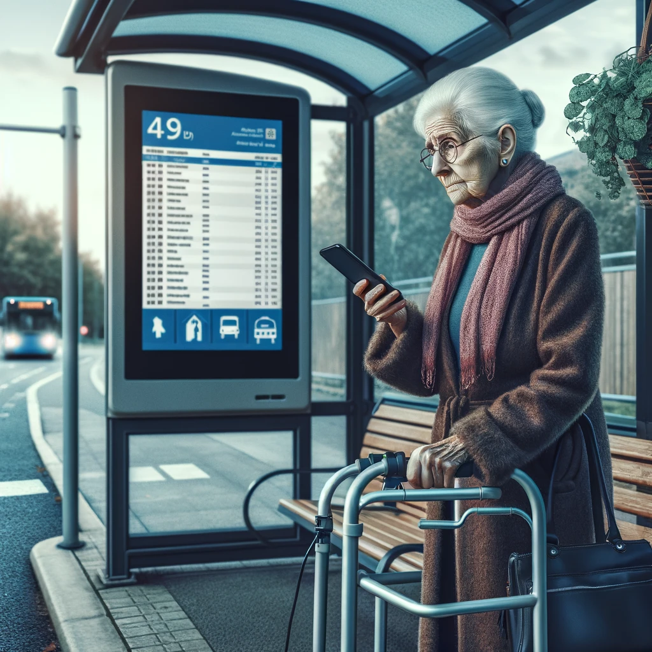
Story of Persona-2
Grandma’s Dilemma
The grandmother has a leg problem and cannot stand in line for too long at the bus stop.
She experiences longer waiting times due to bus delays and has difficulty standing for extended periods.
She wants information on the availability of a shelter at the bus stop to provide relief while waiting.
She wants to finds out which bus are usually not delayed and so she can take those bus insteads.
Notes:
Sijan

Slide 5
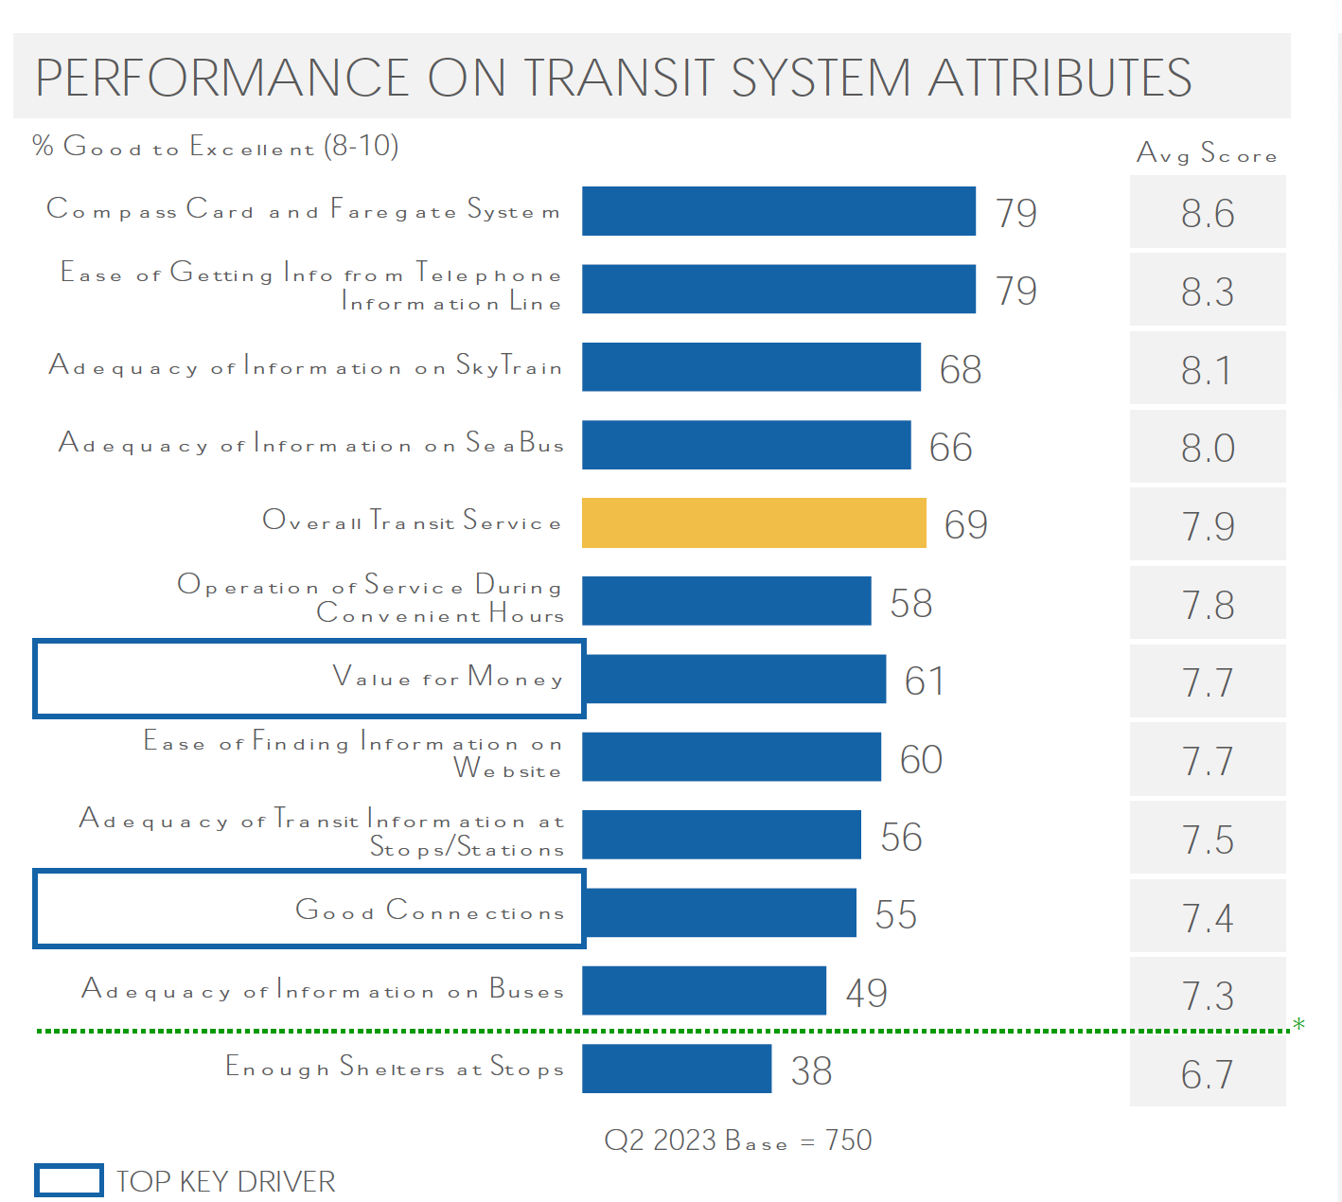
Pain Points
Bus delays causing uncertainty and frustration for commuters.
Lack of real-time transit and shelter information leading to discomfort for most people
Inability to predict wait times and overall travel time causing inconvenience for commuters.
TransLink. 2023. "Customer Service Performance Report Q2 2023." Image. Nov.07,2023
Notes:
Cassie

Slide 6
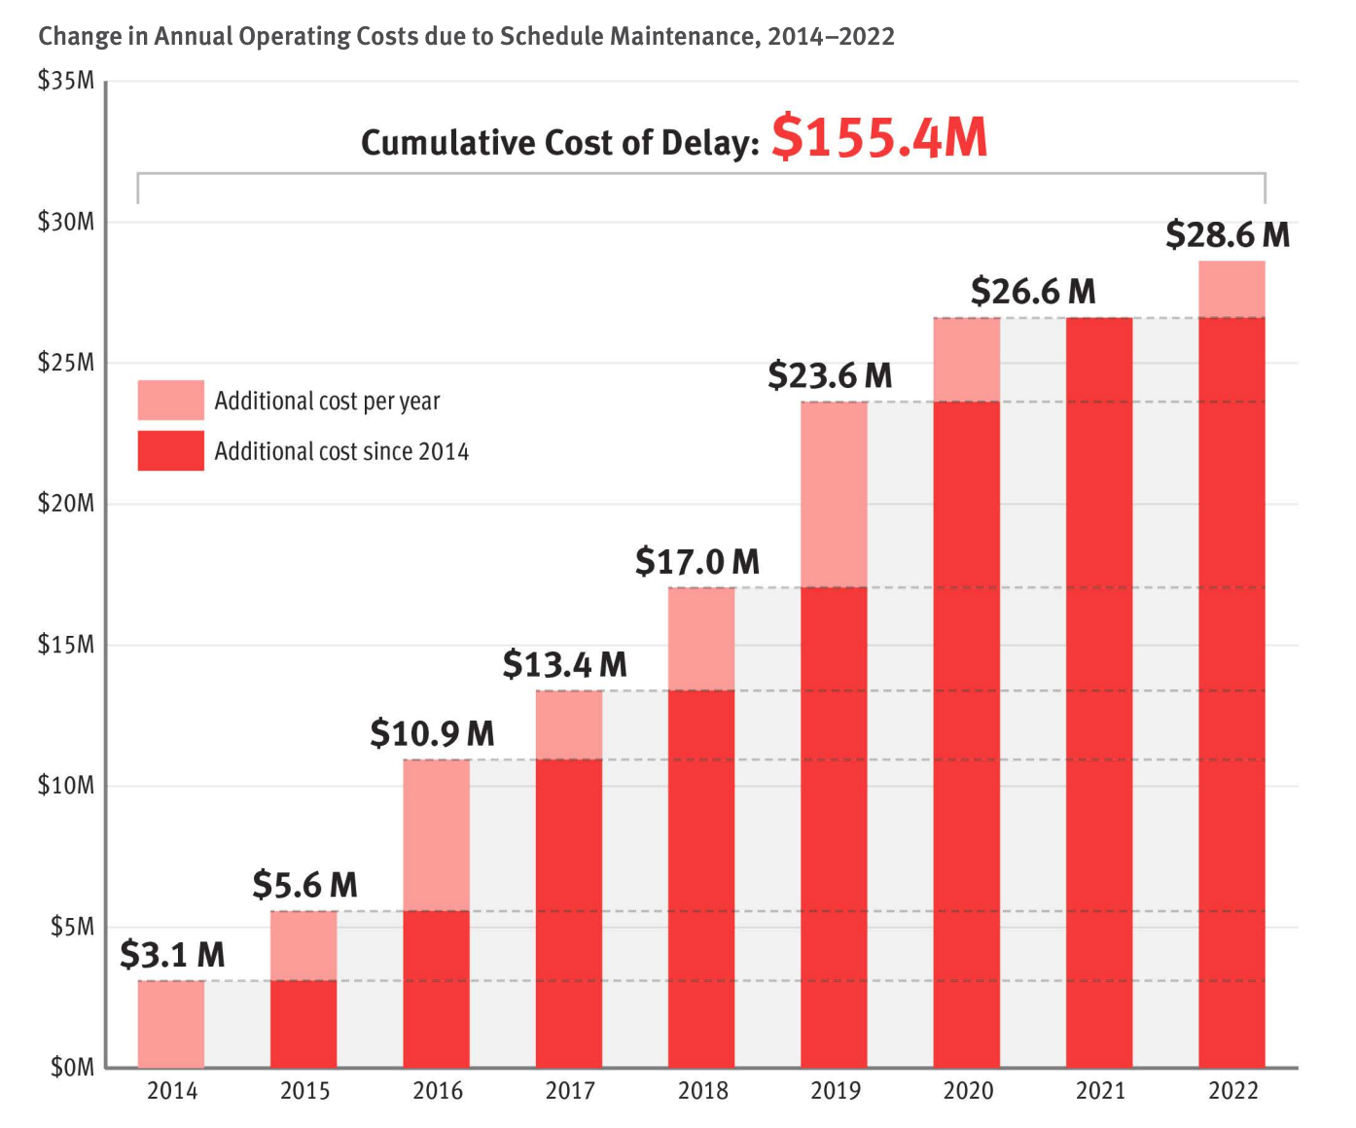
Pain Points-Cost of Delay
TransLink. (2023). Bus speed and reliability: Improvements and initiatives (p. 18).
Notes:
Cassie

Slide 7

Product Overview: CozyCommute
Key Features
Benefits
Real-time nearby bus stops data and their information from Translink Open API
Average delay and prediction of wait time at a stop at a particular time and overall travel time using ML model
Shelter information at bus stops
Increased convenience, awareness and transparency for bus commuters
Reduced uncertainty and wait times at bus stops
Enhanced travel planning and time management for users
Notes:
Sijan

Slide 8
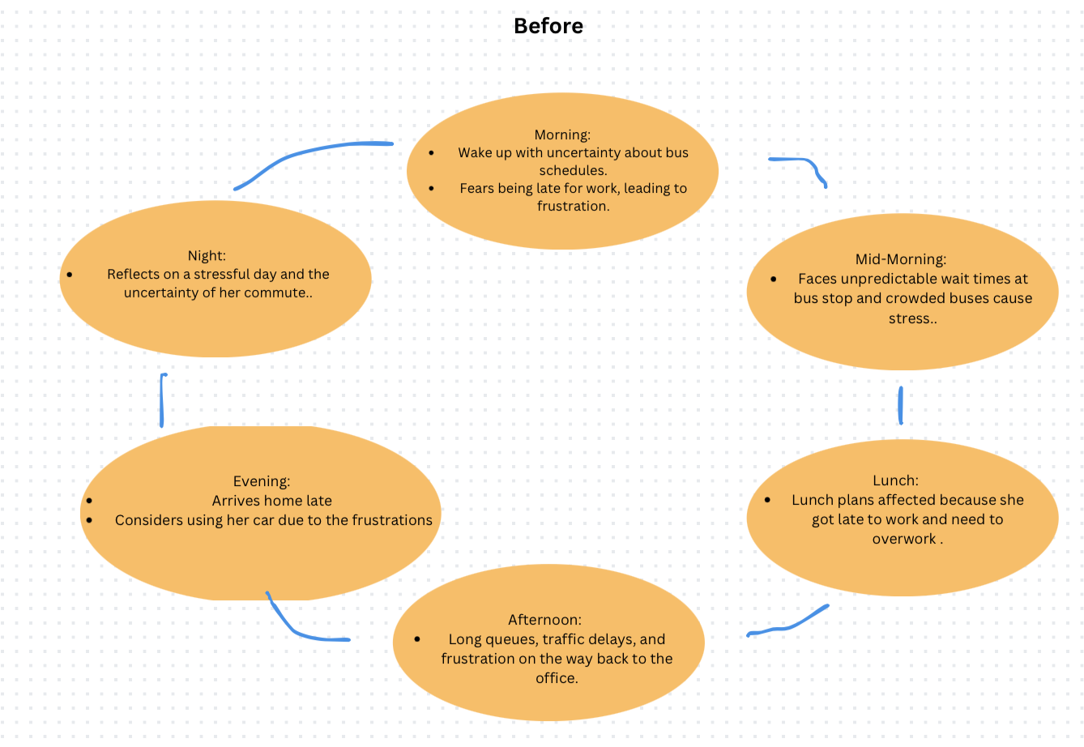
Day in the Life (Before CozyCommute)
Notes:
Sarah faces unpredictable wait times, crowded buses, and uncertainty about the overall travel time, leading to frustration and stress.
Dealing with heavy traffic, long queues at intersections, and frequent delays, resulting in wasted time and energy.
Sarah decides to switch using Car which includes higher carbon emissions, pollution, causing environmental impact

Slide 9
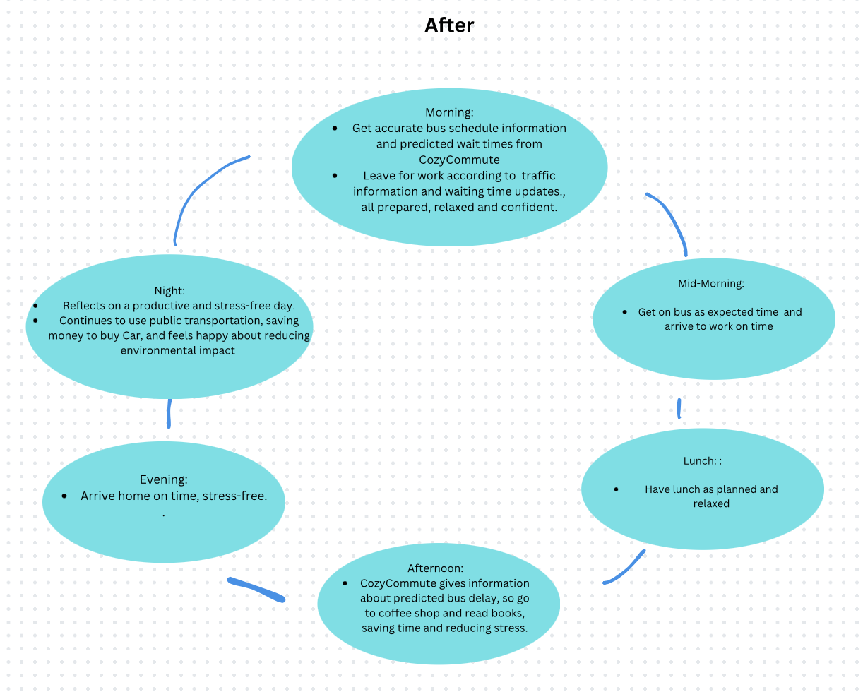
Day in the Life (After CozyCommute)
Notes:
Sarah arrives at work on time, feeling relaxed and stress-free, thanks to the accurate and reliable predicted bus delay and travel time predictions provided by CozyCommute.
During the workday, Sarah receives real-time traffic information and stay updated average waiting time at specific times, allowing her to make informed decisions if any sudden plan comes up.
At the end of the day, Sarah leaves the office with confidence, knowing that CozyCommute will guide her home through the best route, saving her time and reducing stress.

Slide 10


App Demo
Notes:
Sijan

Slide 11



Tech Stack Explored
 | React Native + Expo for frontend
 | Google Reverse Geocoding API to get location name from longitude and latitude for Map
 | Fast API for backend
Translink Open API | RTTI Stops Endpoint for getting nearby stop codes , stop names given specific radius , longitude and latitude GTFS Static Data to Map Stop Code to Stop ID GTFS Realtime Service Alerts Endpoint for real time transit information given specific Stop ID GTFS Realtime Trip Update Endpoint for real time bus delays given specific Stop ID
Notes:
Sijan

Slide 12


Data Assumption
Store Real time data for training ML Model
For average delay prediction, a regression model will be trained using collected real time datas on bus delays which will be stored in database in the backend. It can then be used for analysis to predict future delays for specific time of the day.
For shelter information, crowdsource data will be collected from the users and cross checked and verified which can be used to provide them information on whether the stop has shelter present.
Crowd Source Data

Slide 13
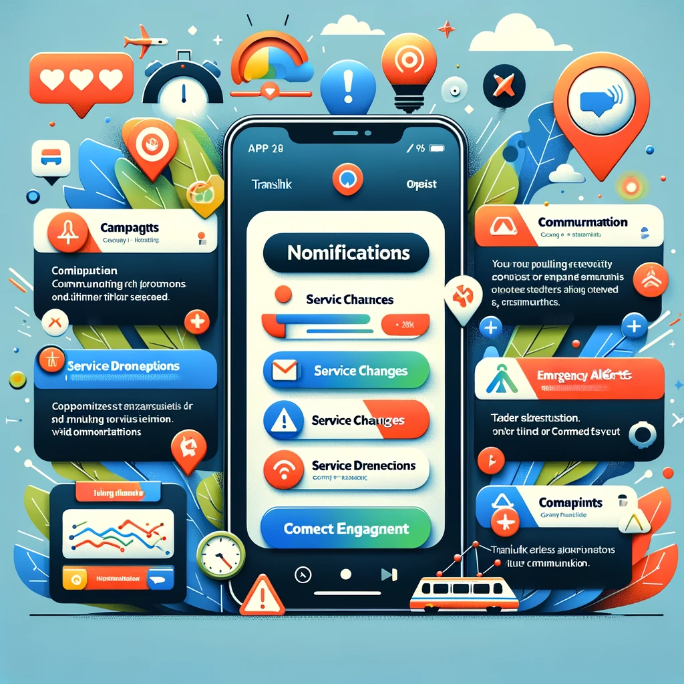
Benefits for Translink
1. New Channel for Engagement
CozyCommute provides a new channel for TransLink to directly offer/broadcast:
Campaign or promotion
Service Changes
Service Disruptions
Emergency alerts
Community connection
Gives potential to increase user retention and experience using TransLink.

Slide 14
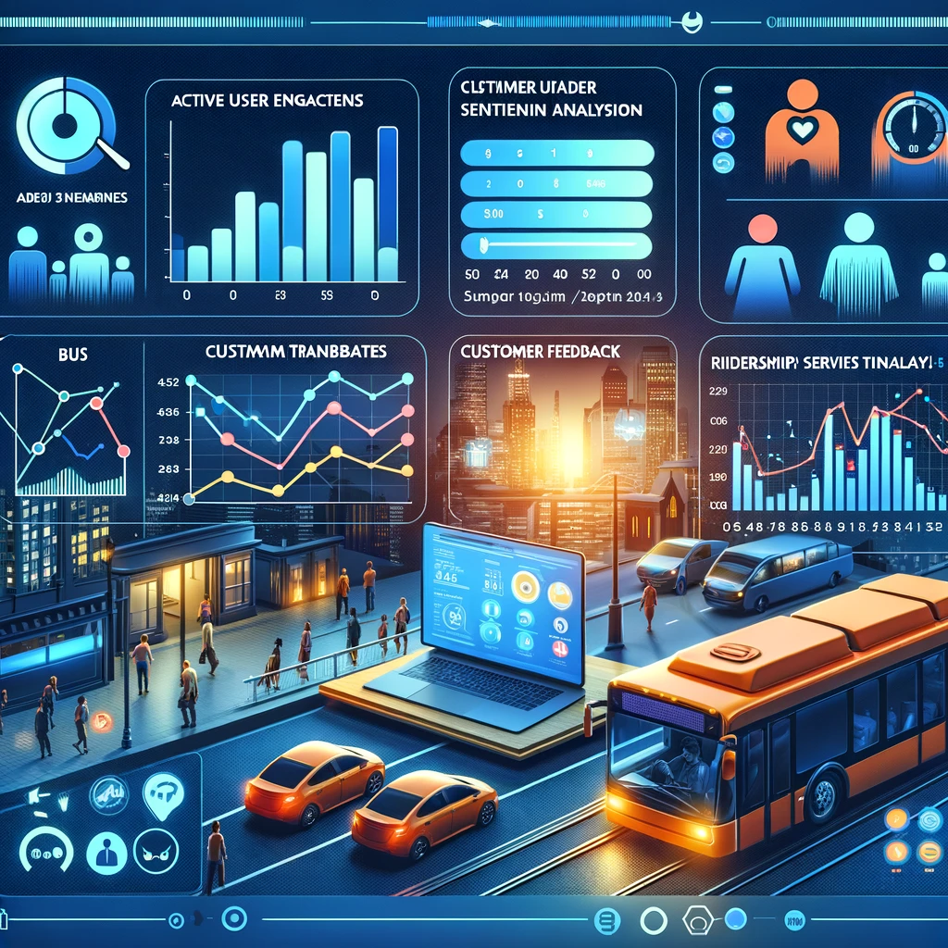
Benefits for Translink
2. More Data for Innovation and Insights
CozyCommute provides new data such as:
Active users and engagements
Frequency and patterns
User Feedback
Change in ridership numbers
Number of riders in specific bus and time
These provides insight and analytics to know the trend and changes during service disruptions, service changes, road closure, etc.
Unlocks future innovation to use this data to plan future services more effectively according to customer’s needs.

Slide 15

Benefits for Customers
Reclaiming Time
There are 2.2 million unique customers using TransLink Bus that spend 700,000 hours waiting yearly.
Using our application, we cut down waiting time up to 90%, equivalent of giving 630,000 productive hours back to the people of Vancouver.
With CozyCommute, every second counts. We're not just saving time; we're enhancing the quality of life for every commuter.
[1]
[2]
https://www.translink.ca/news/2022/may/bus%20ridership%20leading%20the%20return%20to%20transit
https://www.translink.ca/plans-and-projects/projects/bus-projects/bus-stop-balancing#:~:text=,time%20and%20improve%20regional%20transit

Slide 16
Benefits for Customers
2. Accessibility
Within Burnaby, 75% of bus stops lack shelters, out of 968 stops. Across Metro Vancouver, less than half of the 8,400 bus stops have shelters/benches.
With precise information, elderly and mobility-impaired riders can plan trips around bus stops with shelters, leading to a safer, more comfortable waiting experience.
Notes:
To do: Cite the resource

Slide 17

Benefits for Environment
3. Decarbonization
Reduction of delays in public transportation, particularly bus services, can significantly enhance ridership appeal.
By offering a faster and more reliable alternative to private vehicles, we encourage a societal shift towards eco-friendlier transit options. This shift is critical in our collective efforts to lower greenhouse gas emissions and combat climate change.

Slide 18
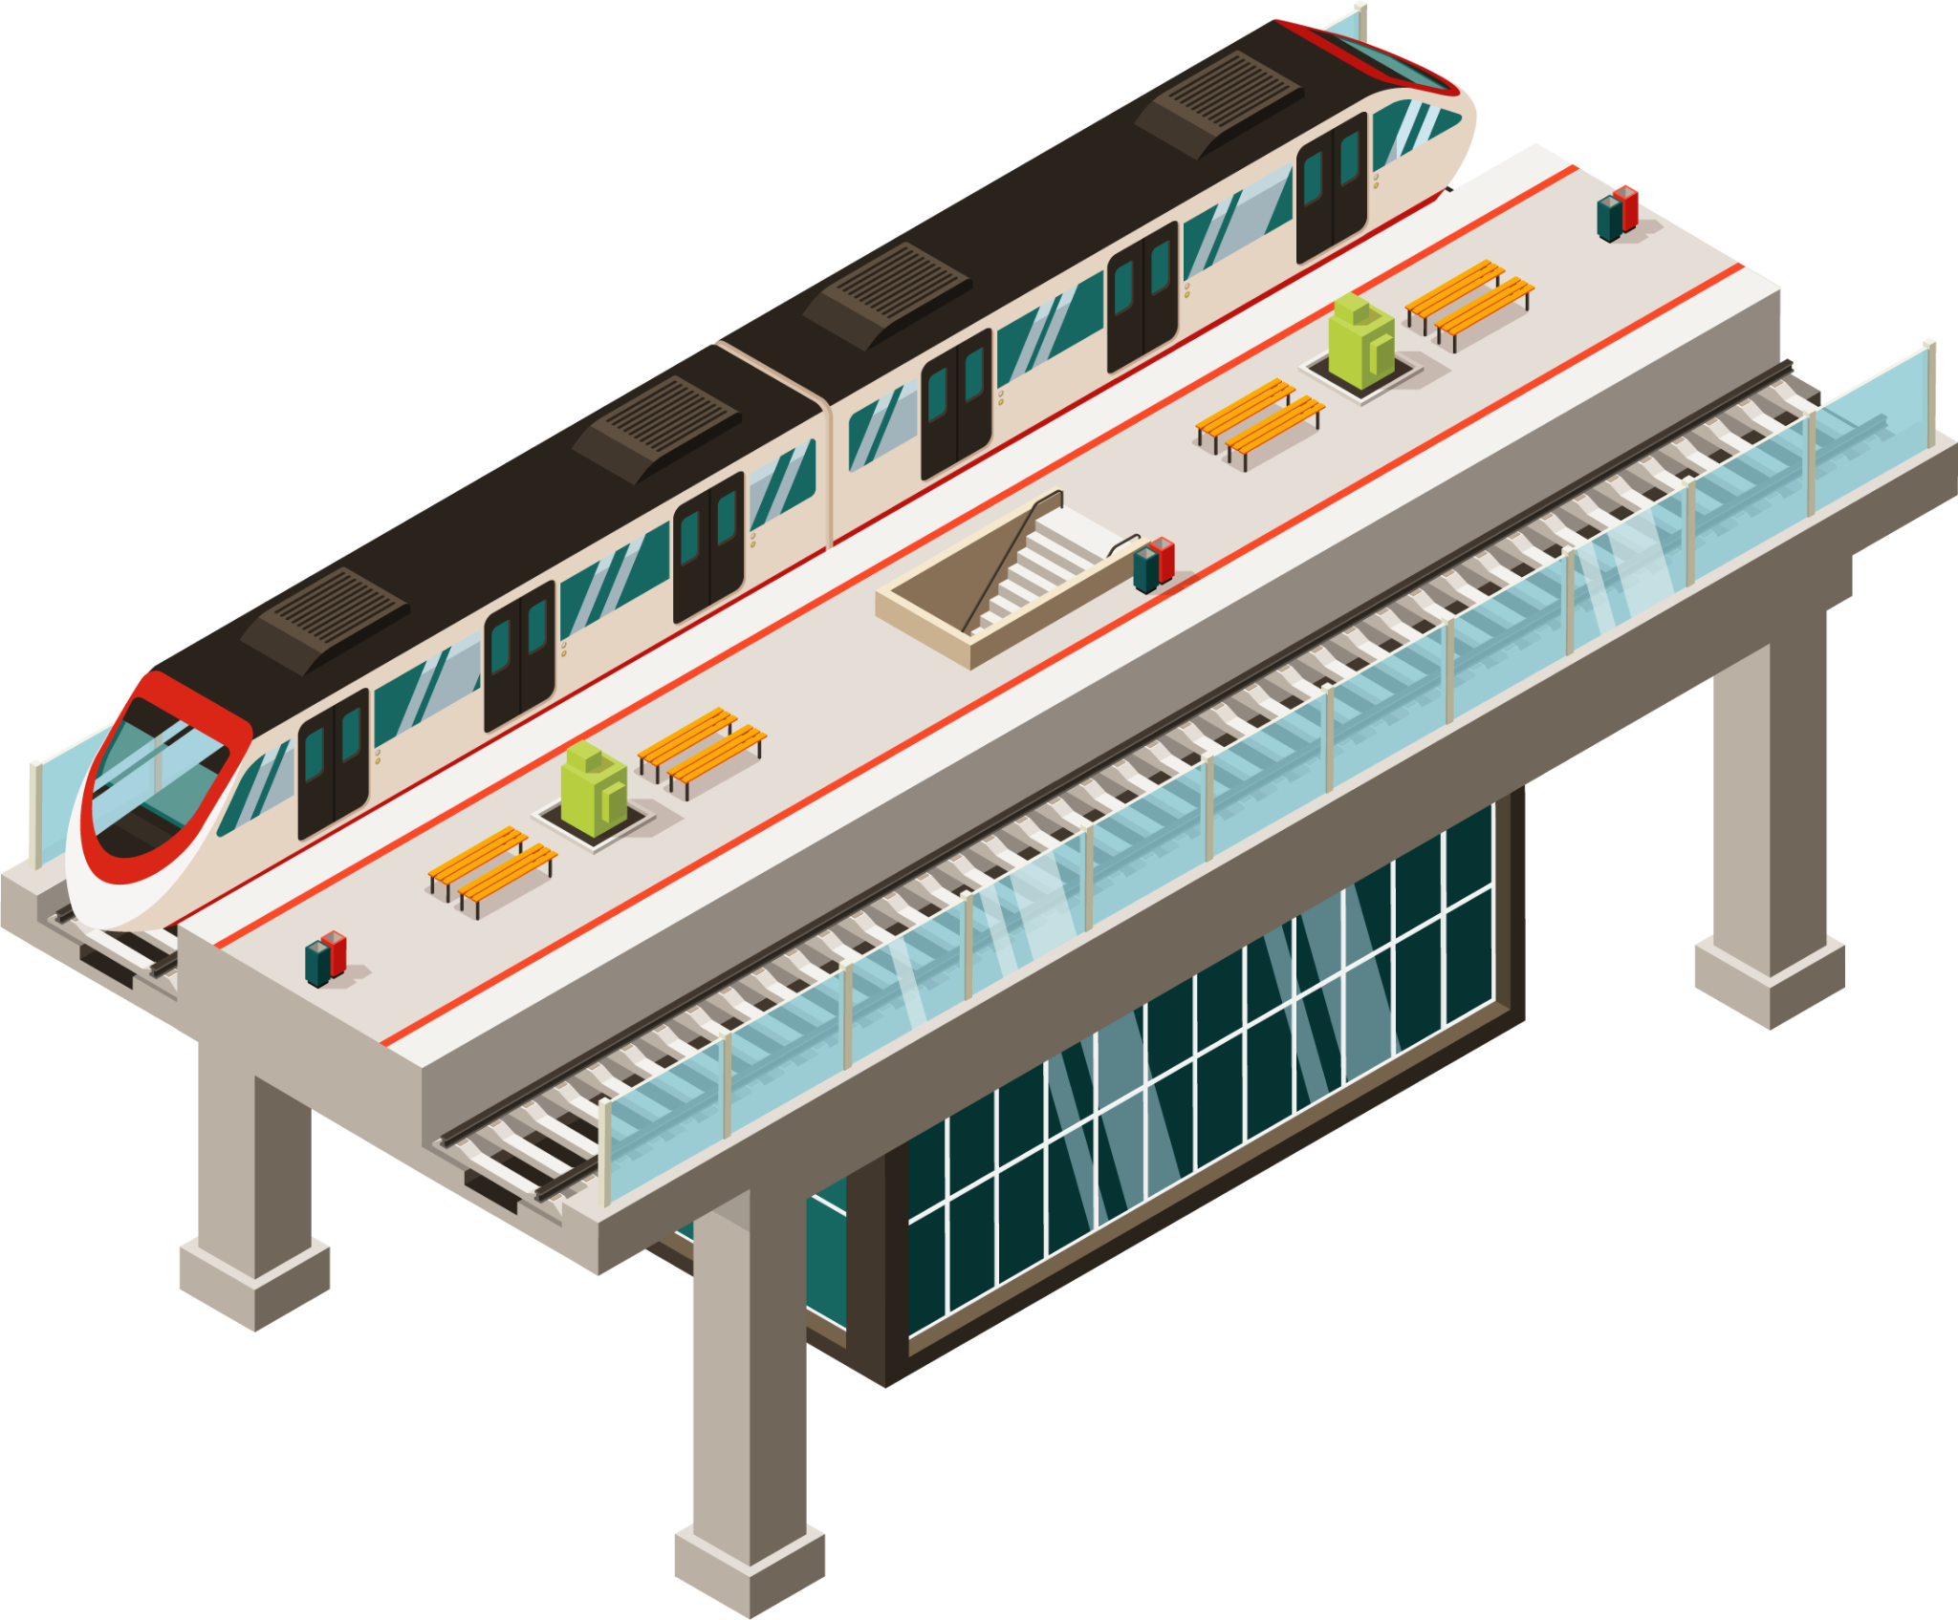
THANKS!
Team 8: Vincentius Roger Kuswara
Sijan Poudel
Wei Song
Ruize Liang

